Slide 1

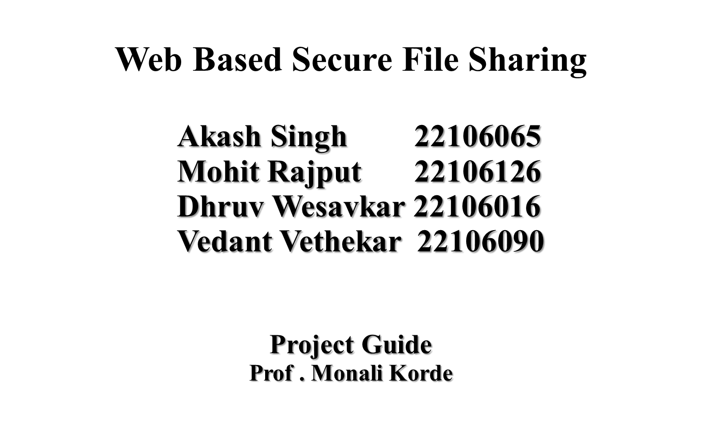

Slide 2
Outline
Introduction
Objective
Literature Survey of the existing systems
Problem statement
System Design
Block Diagram
Technologies and methodologies
Implementation
Conclusion
References

Slide 3
Introduction
Digital Sharing Landscape: In an increasingly interconnected world, file sharing is ubiquitous across personal and professional domains.
Security Imperative: However, with rising cyber threats, ensuring the safety of shared data is paramount.
Solution: It emerges as a solution, offering robust security measures without compromising user experience.
User-Friendly Interface: Features an intuitive interface for seamless navigation and enhanced user experience.
Vision: It aims to redefine the standards of secure file sharing, empowering users to exchange information with peace of mind in an evolving digital landscape.

Slide 4
Objective
Facilitating efficient and secure digital file sharing, our platform aims to streamline collaboration and communication.
We prioritize user-friendly interfaces and robust security measures to ensure seamless sharing experiences.
Our objective is to foster productivity and innovation by providing a reliable platform for individuals and teams to exchange files effortlessly.
With a commitment to accessibility and data integrity, we strive to empower users to manage, share, and collaborate on their digital assets with confidence, enhancing productivity and driving success in a rapidly evolving digital world.

Slide 5
Literature Survey of the existing system
Title of Paper | Author | Description | Link
[1]Shopbots and pricebots | Greenwald, Amy R., and Jeffrey O. Kephart. | Shopbots are software agents that automatically gather and collate information from multiple on-line vendors about the price and quality of consumer goods and services | https://link.springer.com/chapter/10.1007/10720026_1
[2]The impact of shopbot use on prices and price dispersion | Tang, Zhulei, Michael D. Smith, and Alan Montgomery | a period of rapid expansion in shopbot use. We find that a 1% increase in shopbot use is correlated with a $0.41 decrease in price levels and a 1.1% decrease in price dispersion. | https://www.sciencedirect.com/science/article/abs/pii/S0167718710000469
[3]Price comparison, price competition, and the effects of shopbots. | .Passyn, Kirsten A., Memo Diriker, and Robert B. Settle | Two ShopBots were used to determine high-to-low price dispersion for identical models of 25 consumer durables, in 2007 and again in 2011, revealing substantial but declining price dispersion ratios. | https://www.clutejournals.com/index.php/JBER/article/view/8068
[4]"Designing interaction for chatbot-based conversational commerce with user-centered design | Pricilla, Catherine, Dessi Puji Lestari, and Dody Dharma. | Therefore, an interaction and interface design for chatbot-based conversational commerce are developed in this study using user-centered design. The outcome of this study is a prototype that fulfills the usability goal and the user experience goal defined for chatbot-based conversational commerce on mobile platform especially for Indonesian users. | https://ieeexplore.ieee.org/abstract/document/8541320

Slide 6
Problem statement
Existing file-sharing platforms lack comprehensive security measures, exposing sensitive data to potential risks and vulnerabilities.
Users are concerned about the possibility of unauthorized access and data breaches, undermining trust in the confidentiality of shared information.
Weak authentication mechanisms contribute to uncertainties regarding data privacy during transmission and storage.
There is a pressing need for the development of a secure file-sharing website that addresses these shortcomings by implementing robust security protocols and providing a user-friendly experience, ensuring the protection and confidentiality of shared data.

Slide 7
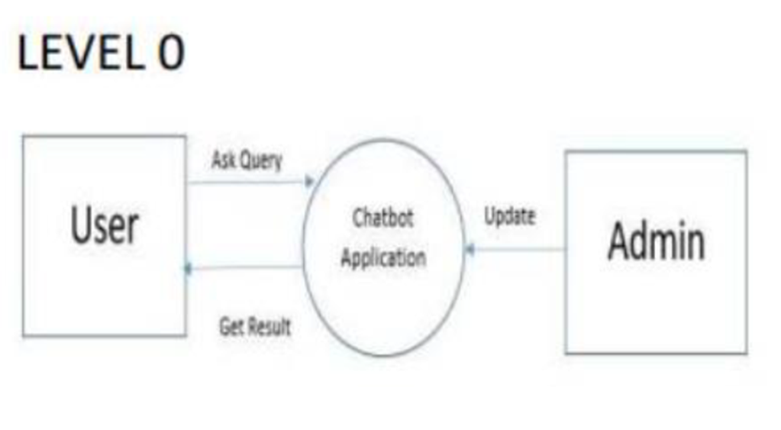
System Design

Slide 8
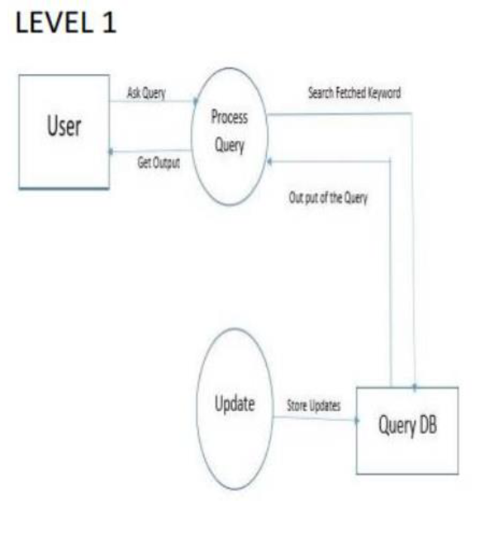

Slide 9
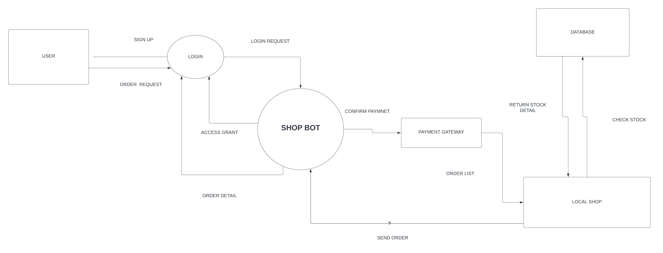
BLOCK DIAGRAM

Slide 10



Technologies and methodologies
Software Requirement
Platform :- Windows
Database :- Firebase store
Frame Work:- Android Studio
Development Tool:- Android Studio
Language:- Java, Xml
API:-Brainshop API

Slide 11
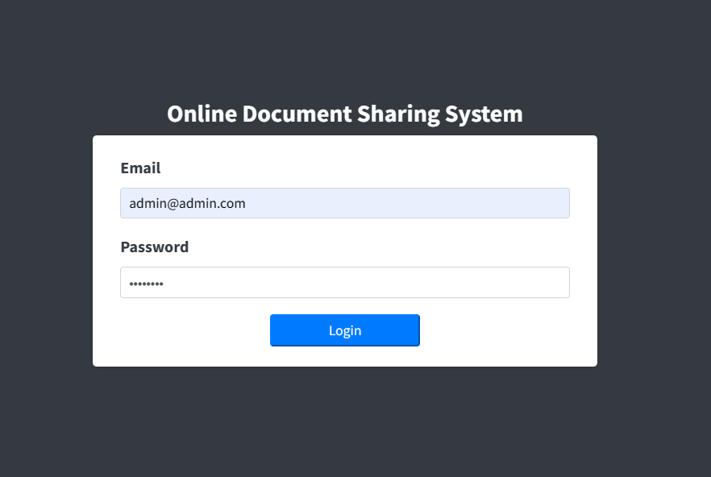
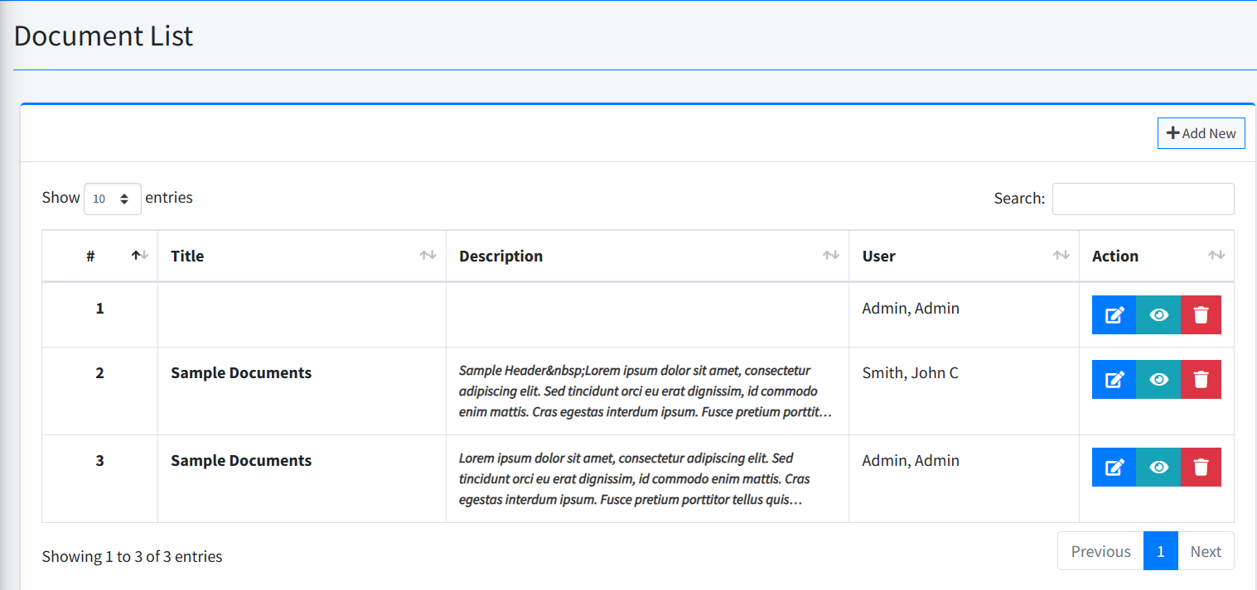
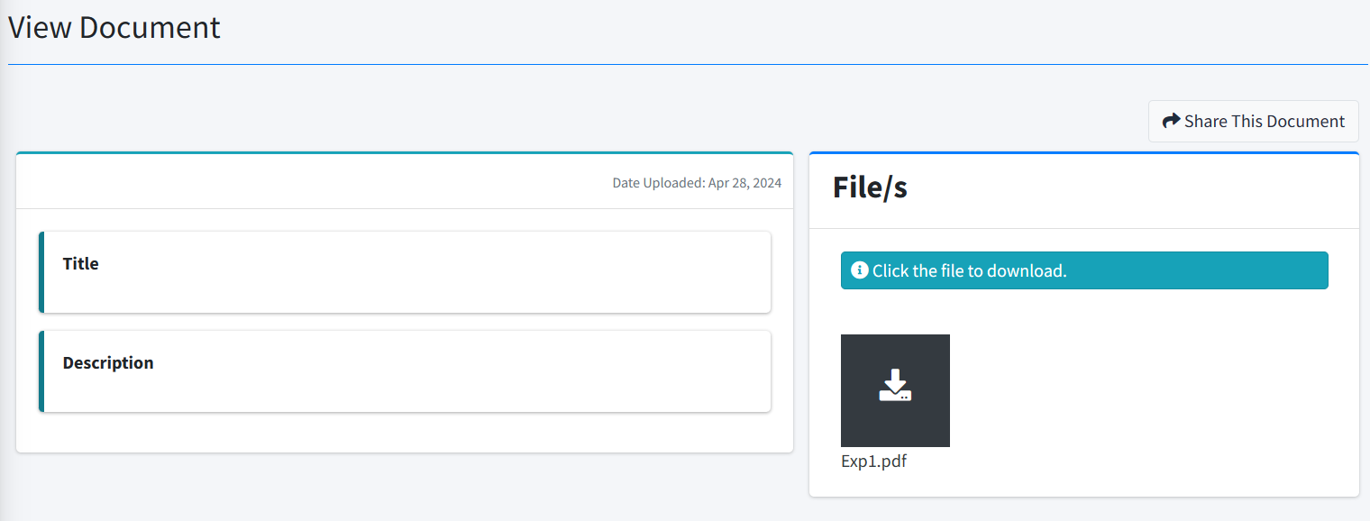
Implementation

Slide 12
Conclusion
The development of a comprehensive file-sharing platform addresses the critical need for secure and efficient collaboration in modern work environments. By implementing advanced user management functionalities, robust access controls, and intuitive file organization tools, the platform enhances productivity and data security. The project's focus on usability and security ensures a seamless user experience while safeguarding sensitive information. Through careful consideration of hardware and software setups, organizations can deploy a reliable file-sharing solution tailored to their specific requirements. Ultimately, the proposed platform offers a valuable tool for fostering collaboration, streamlining file sharing, and enhancing overall efficiency in today's dynamic work environments

Slide 13
References
Kallahalla, Mahesh, Erik Riedel, Ram Swaminathan, Qian Wang, and Kevin Fu. "Plutus: Scalable secure file sharing on untrusted storage." In 2nd USENIX Conference on File and Storage Technologies . 2003
Castiglione, A., Catuogno, L., Del Sorbo, A., Fiore, U. and Palmieri, F., 2014. A secure file sharing service for distributed computing environments. The Journal of Supercomputing, 67, pp.691-710
Seeland, Josh, Sarah Elaine Eaton, and Brenda M. Stoesz. "Leveraging college copyright ownership against file-sharing and contract cheating websites." Contract Cheating in Higher Education: Global Perspectives on Theory, Practice, and Policy. Cham: Springer International Publishing, 2022. 61-76.
Oberholzer-Gee, Felix, and Koleman Strumpf. "The effect of file sharing on record sales: An empirical analysis." Journal of political economy 115.1 (2007): 1-42
https://www.researchgate.net/publication/123456789/Secure_File_Sharing_Using_End-to-End_Encryption_in_Web_Applications
https://www.oreilly.com/library/view/web-development-with/9781491991725/
https://link.springer.com/chapter/10.1007/978-3-031-12680-2_5
https://www.journals.uchicago.edu/doi/abs/10.1086/511995

Slide 14
Thank You...!!

